Slide 1

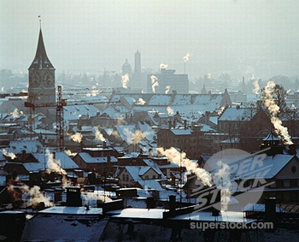




OpenSense
Open Community Driven sensing of the Environment
Karl Aberer, Saket Sathe, Dipanjan Charkaborty,
Alcherio Martinoli, Guillermo Barrenetxea,
Boi Faltings, Lothar Thiele
EPFL, IBM Research India, ETHZ

Slide 2
OpenSense Vision
  Community driven, large-scale air pollution measurement in urban environments
Important problem:
air pollution
  Affects quality of life and health
  Urban population increasing
  Air pollution is highly
  location-dependent
    traffic chokepoints
    industrial installations
Few monitoring stations measure pollutants
Important technical opportunities and challenges
  Massive measurements that exploit
    Wireless sensor networks
    Mobile stations
    Community involvement
  More data, more noise, but also more redundancy
Can we produce better quality data?
Address key challenges in communication and information systems for urban air quality monitoring

Slide 3
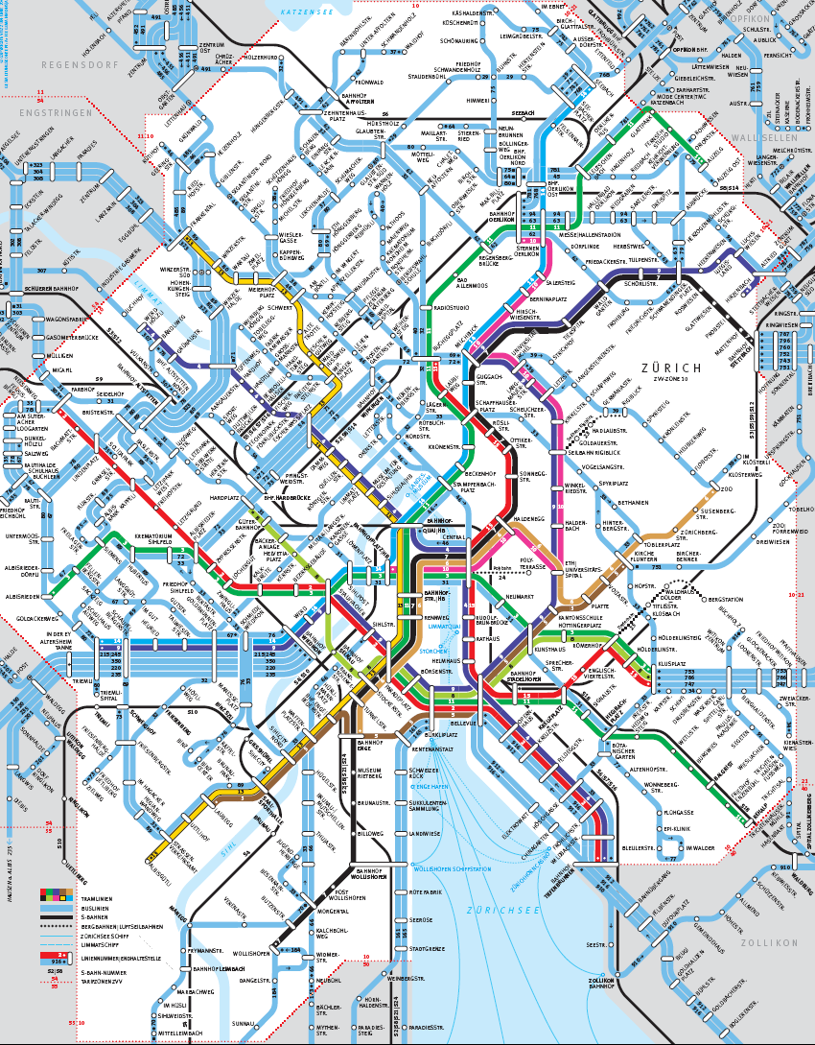
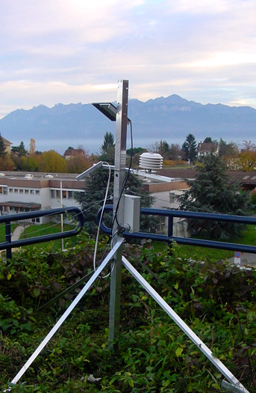
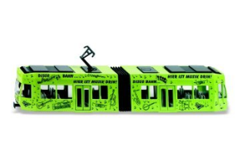
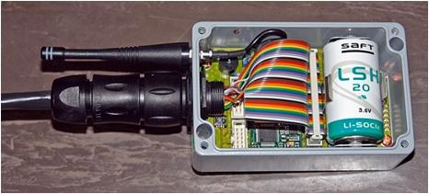

Basic Sensing Infrastructure
  Mobile sensor nodes on
  public transportation and private mobile devices
  Wireless sensing and communication infrastructure

Slide 4
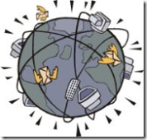
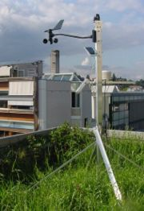
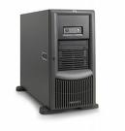
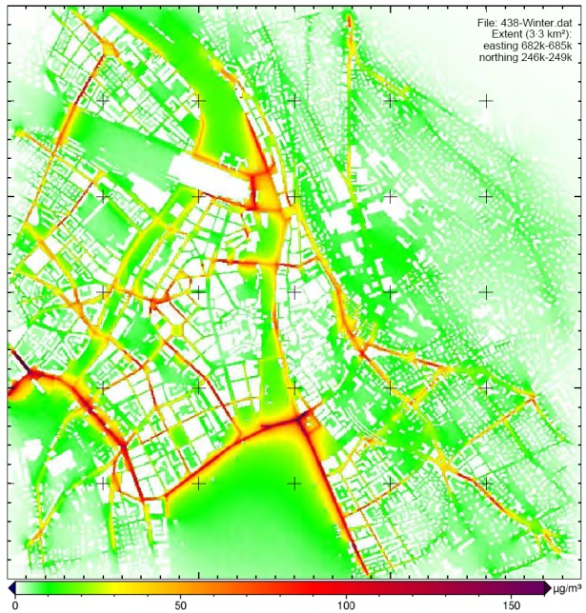




Overall Goal
  SENSING SYSTEM
  From many wireless, mobile,
  heterogeneous, unreliable raw
  measurements …
  INFORMATION SYSTEM
  … to reliable, understandable and
  Web-accessible real-time information
  NANO
  TERA
sensor network control
optimization of data acquisition
wireless
fixed nodes
interpretation and
presentation of data
mobile nodes
Internet
GPRS
GPS

Slide 5
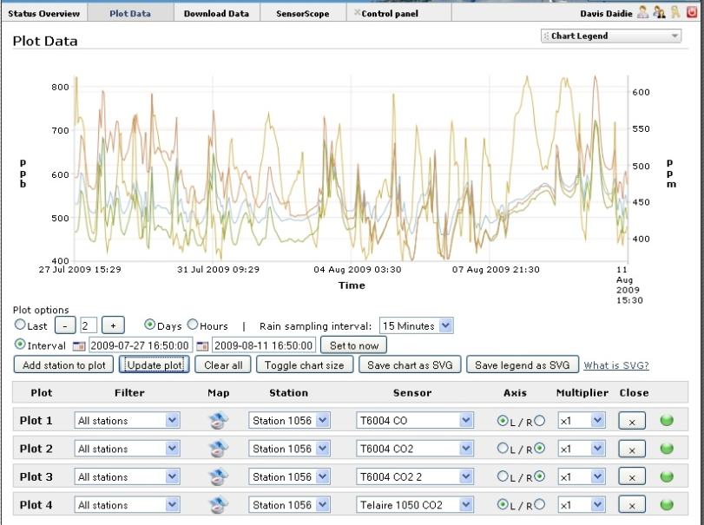
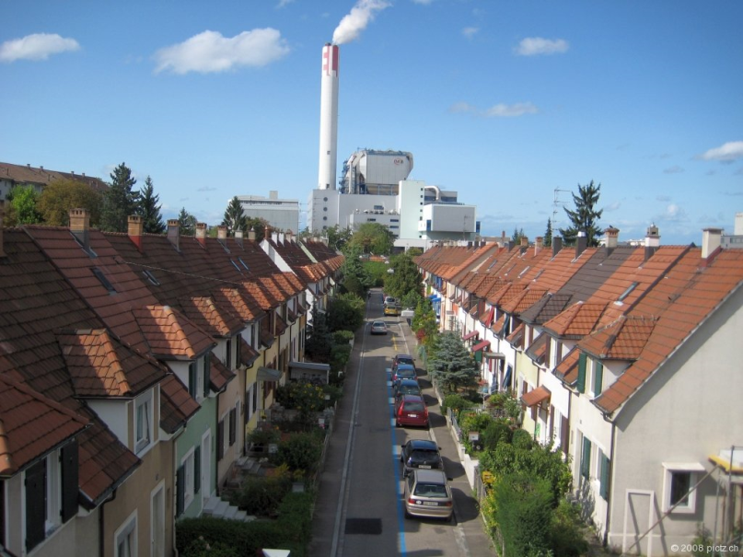
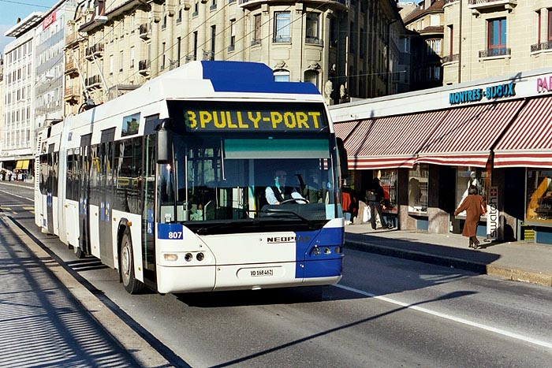
Users and Deployments
Collaboration with ISPM* of
University of Basel, SALPADIA
  First test deployments
  already made
    CO, CO2, fine particles, NO2
  Deployment in city of Basel
Field test in Lausanne
  Lausanne transport agreed to
  install sensors on buses
*Institute of Social and Preventive Medicine

Slide 6
Community Sensing
Several small-, micro-, or potentially even nano-scale sensors participating in an open “opt-in” model
Advocates microscopic monitoring of the environment
Several observations
  Ownership and participation (private/public sensors)
  Heterogeneity of equipments
  Data Sampling (users invest power resources; frequent sampling is infeasible)
  Mobility: un controlled/ semi controlled
  Reliability
  Trust-worthiness
  Privacy
Community sensing faces substantial technical challenges to scale up from isolated, well controlled, small-user-base trials to an open and scalable infrastructure.

Slide 7
Towards Sustainable Community Sensing
Community sensing networks, in order to be widely deployable and sustainable, need to follow utilitarian approaches towards sensing and data management
  Unlike traditional environment sensing principles
Utilitarian approaches
  models utility of data being produced and consumed
  Uses utility to control data production
The environment should be spatially and temporally sampled (and visualized) only at the rate necessary, and not necessarily at the rate to reconstruct the underlying phenomenon.

Slide 8
Sensor Infrastructure
Application, Middleware, Management Infrastructure
- Private and public sensors
Uncontrolled mobility
Heterogeneous sensors
Unreliable, privacy-sensitive
Sensed Data → Basis for decision
making
Mobile Sensors (Cell phones, vehicle mounted gas sensors, GPS from cars etc)
Decision Making
Application/community demands
Available spatio-temporal distributions, deviations
Error handling
Energy efficiency
Data Management costs
Privacy, trust, reputation
Utility Feedback → Incentive for
Sensing
OpenSense Cycle

Slide 9
Realizing the vision..
1. Framework needs to consider several dimensions of the geosensory eco-system to model the utility of data produced and consumed
2. Decentralized control system for utility-driven management of the network
Sensing Model
Data Management Model
Error Handling Model
Energy Management Model
Privacy and Reputation Model
Application Demand Model

Slide 10
Management of the Cycle
Phases
  Sense: sensing environmental pollution parameters
  Transmit: Exchanging data with base stations (communication costs)
  Store: Efficient storage
  Query: querying data based on application demands
  Archive: archiving old/unused data
Common entity connecting these layers is data, which moves from sensors to applications
  Important resources are utilized at every phase
Opensense would quantify and track the importance of data at every phase, measuring utility as a function of local factors and dependencies from next layers

Slide 11
On going work
Deployments
Model development
Data Management strategies
Decentralized decision making and control
OpenSense URL
http://www.nano-tera.ch/projects/401.php
Thank You

